Slide 1
Dog Behavioural Monitoring System
2020_045
Final Presentation & Viva

Slide 2

Overall Project Description
Introduction
Developing a mobile application which tracks and monitors the behaviour of the pet dogs.
This application will track the unusual behavioural changes and notify the user.
Research Problem
Dogs may undergo different health conditions which are not noticed by their owners.
Differences in the behaviors such as resting, walking, barking behaviour of the pet dog based on breed and age should be noticed by the owners in order to identify their unusual behaviors.
Research Objectives
Main Objective
Tracking the behavioral changes of the dogs using image processing and machine learning concepts and notifying the pet owners via a mobile application is the main objective of this research.
Sub Objectives
Identify the dog breed using computer vision and specify the unique characteristics of the dog.
Analyze the walking behavior pattern of the dog based on breed and age using machine learning algorithms.
Analyze the resting behavior pattern of the dog based on breed and age using computer vision.
Analyze the unusual barking behavior patterns of the dog using computer vision and audio analysis.

Slide 3
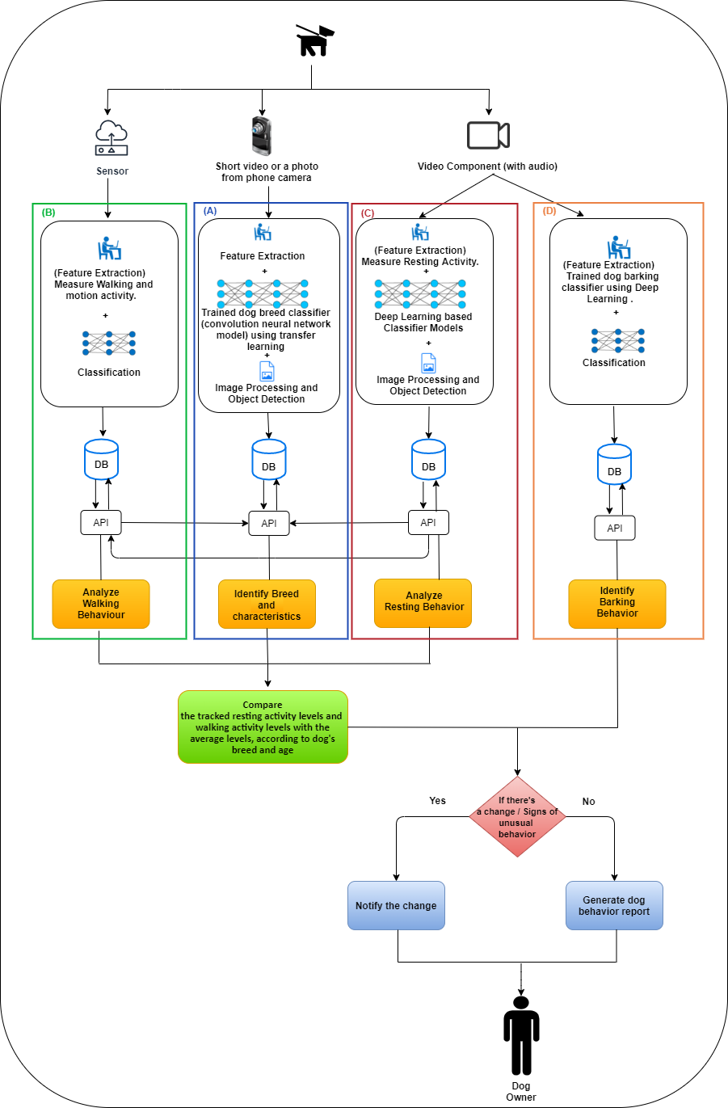
Overall solution as a system diagram

Slide 4
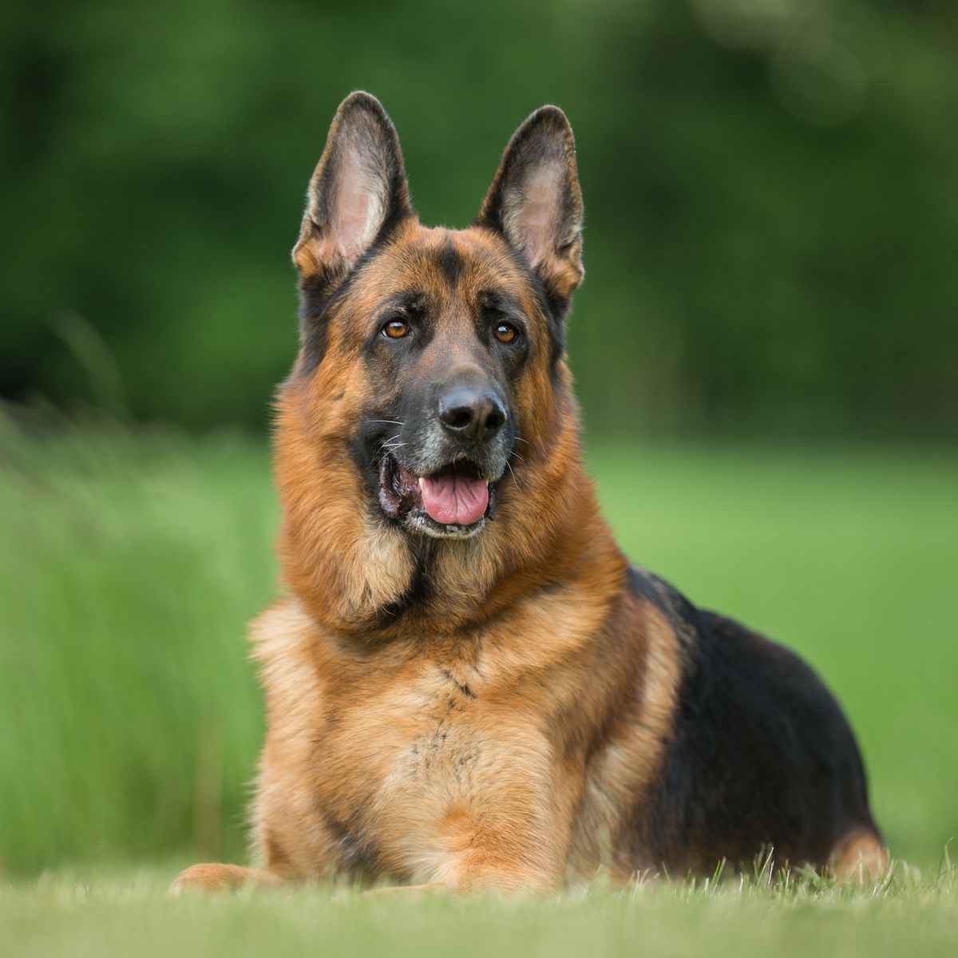
System Requirements
Functional Requirements
Identify dog breed of the dog in the video or image.
Provide resting time and the activity level of the identified dog breed.
Dog activity recognition - walking, running, resting, barking.
Measure walking activity of the dog using IMU sensor.
Measure resting activity of the dog using CCTV camera video feed.
Notify the user if there is an unusual change in activity levels(walk,run,rest) based on breed and age.
Dog barking behaviour identification for different situations using CCTV camera audio feed.
Notify the user if there is an unusual change in identified barking behaviour.
Non-functional Requirements
Efficiency
Accuracy
Accessibility

Slide 5
Social Aspect
System usage is less complex and easy to understand.
Suitable for Sri Lankan environment.
Privacy of the system data is protected by security mechanisms with confidentiality, integrity and availability.
No harm or disturbance for the dog.
Faster and better functional performance with the latest and open source technologies.
Commercial Aspect
In Sri Lanka, there are no applications to track the unusual behavioural changes of a dog and identify them.
In Sri Lanka, there are only GPS trackers to identify the location of the pet.
This application helps the user to track the activity level of the dog and identify any unusual patterns.
Low cost
This system is build using only a basic IMU sensor and regular CCTV camera with clear audio recognition to identify the behavioural changes of the dog.
Accuracy & Efficiency
Daily generated behavioural reports regarding the activity levels of the dog.

Slide 6

Dog Breed Identification
IT16175426
Herath HMKS
2020-045

Slide 7
Background / Research Gap
There are systems that can identify dogs’ breed using image processing but moving beyond that approach, currently there are no systems that have the ability to sort out the behavioral patterns such as resting and walking based on the identified breed of the dog.
IT16175426
Herath HMKS
2020-045

Slide 8
Research Question
How to use dog breed identification to track unusual behaviors of a specific dog breed?
How image processing can be used to identify dog breeds?
IT16175426
Herath HMKS
2020-045

Slide 9
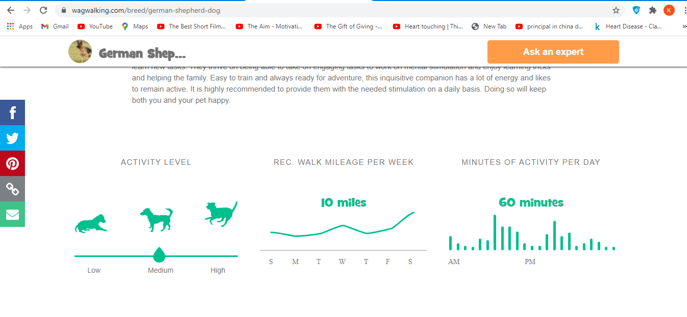
Objectives
Predict the pet dog breed in the video or photo using image processing.
Store standard resting hours and active hours of different dog breeds which are obtained from the wagwalking.com site [6], according to their age in the database.
Standard data in the wagwalking site
IT16175426
Herath HMKS
2020-045

Slide 10
Methodology
In order to identify the breed of the dog, the dog owner is asked to upload a photo or a small video of the dog via the mobile application. For identification of the dog breed, uploaded photo or small video is processed through the Inception V3 model which is trained to identify dog breed using transfer learning.
The dog breed which is identified using the photo or small video uploaded by the application user and the basic information regarding the dog like birthday, name, gender which are also input by the user through the application will be stored in the database. The resting time periods and the active time periods according to the two breeds (Pomeranian and German Shepherd) analysed in this proposed system and the age calculated according to the user input birthday will be stored.
IT16175426
Herath HMKS
2020-045

Slide 11
Methodology
An API is developed using flask framework to handle the communication between the dog breed identification model and the mobile application.
The API has a endpoint called ‘/predict’ , from the mobile application a post request is submitted to this url with user uploaded photo or video. Then in the API first the file type of the uploaded file is checked if it is a video or an image.
If the uploaded file is an image ‘predict_from_image’ function is called. There the image is pre-processed using image generator function which uses tensorflow to preprocess the image. And the preprocessed image is passed to the predict function to make the prediction of the breed.
IT16175426
Herath HMKS
2020-045

Slide 12
Methodology
If the uploaded file is a video ‘predict_from_video’ function is called. There the video’s frame rate is reduced 5 and then it is splitted into frames and each frame is preprocessed using image generator function and passed to the predict function to make the prediction. Prediction probability of each frame is assigned to an array. At last the maximum probability breed is taken as the prediction.
IT16175426
Herath HMKS
2020-045

Slide 13
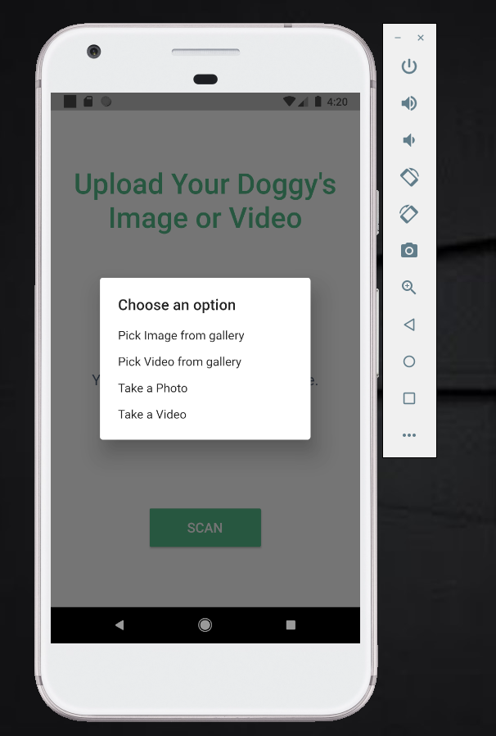
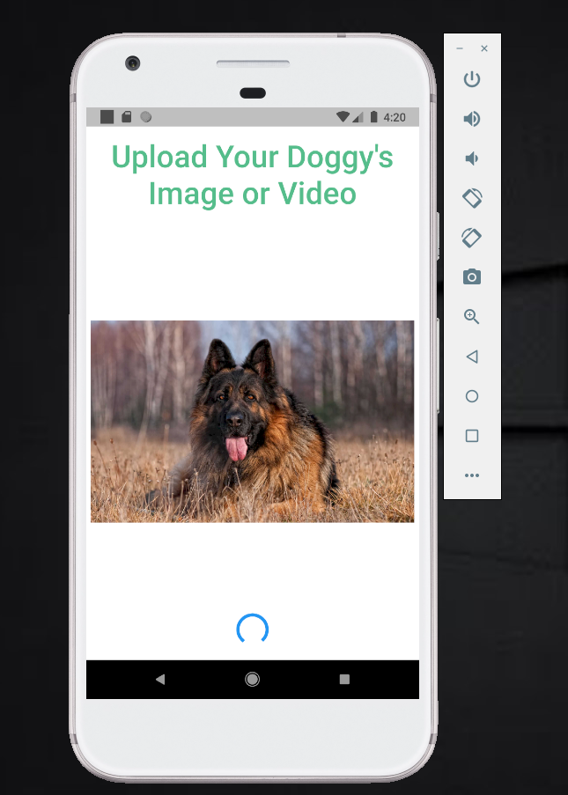
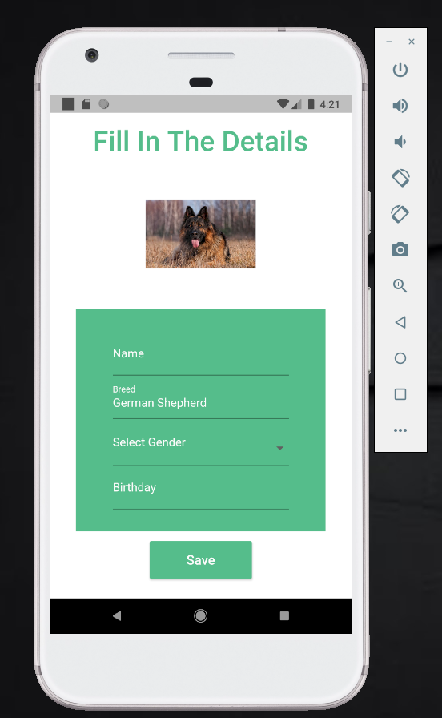
IT16175426
Herath HMKS
2020-045

Slide 14
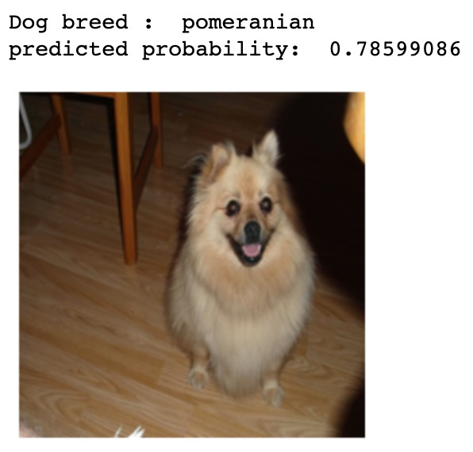
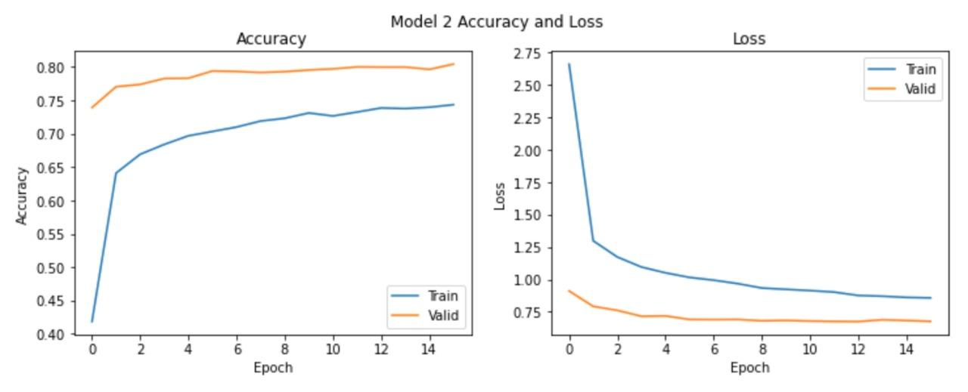
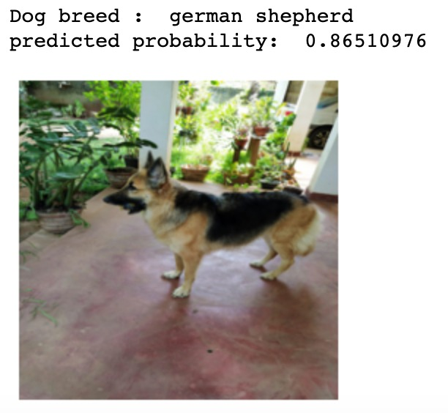
Achievements
Inception V3 model accuracy - 89%+
IT16175426
Herath HMKS
2020-045

Slide 15

Walking Pattern Recognition
IT17133678
Boteju W.J.M
2020_045

Slide 16
Background / Research Gap
There are systems that can identify dogs’ breed using image processing but moving beyond that approach, currently there are no systems that have the ability to sort out the Walking Behavioral patterns based on the identified breed of the dog.
IT17133678
Boteju W.J.M
2020_045

Slide 17
Research Question
● How IMU sensors can be used to track dogs’ behavioral changes?
● Dog Activity Recognition (Walk, Run) since there may be confusion between distinguishing running activity from walking activity.
● Analyze whether the pet dog has the appropriate behavior according to its breed and to its age?
● How to track the changes in walking and motion activity levels using an IMU sensor?
IT17133678
Boteju W.J.M
2020_045

Slide 18
Objectives
Main objective
The main objective of the proposed research component is to build up a system that can track and monitor the walking activity levels of dogs according to their breed and age.
IT17133678
Boteju W.J.M
2020_045

Slide 19
Objectives
Sub Objectives
● Sub-Objective 1: Dog Activity Recognition (Walk, Run).
● Sub-Objective 2: Measure walking activity of the dog using an attached IMU Sensor device.
● Sub-Objective 3: Calculate average walking activity of the dog during normal health conditions.
● Sub-Objective 4: Compare walking and motion activity with average walking activity according to the breed and age and analyze the results.
● Sub-Objective 5: Notify if there is a change in walking and motion activity levels.
IT17133678
Boteju W.J.M
2020_045

Slide 20
Methodology
Technological Approach
Models | Support Vector Machine
Programming languages | Python, C++, Dart
Libraries | Keras, SciKit learn, Arduino
Application Programming Interface (API) | Django REST framework, Arduino Server
Database | MongoDB
Version Controlling | GitHub
IT17133678
Boteju W.J.M
2020_045

Slide 21
Methodology
In order to measure the walking and motion patterns of the dog, an IMU sensor (6DOF MPU6050) which consists of a triaxial accelerometer and a triaxial gyroscope is attached to the collar of the dog along with a NodeMCU Wifi development board.
The raw data obtained from the IMU sensor is obtained using a NodeMCU Wifi development board with the help of the Arduino IDE by running an Arduino Web Server.
IT17133678
Boteju W.J.M
2020_045

Slide 22
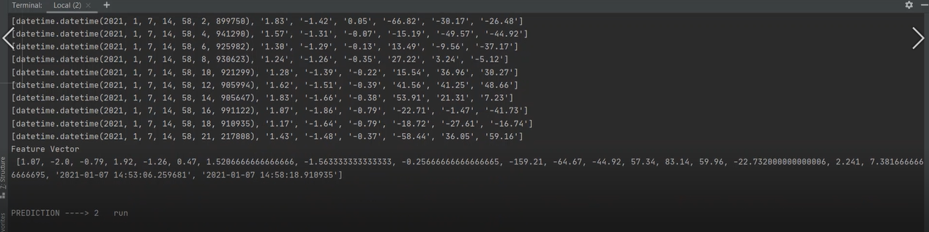
The raw data obtained from the MPU6050 sensor is displayed below. (AccX, AccY, AccZ, GyrX, GyrY, GyrZ)
Once the raw data is obtained, the feature vector (Mean , Maximum Peak , Minimum Peak) is created and it will be passed through an activity classifier with the help of a standard machine learning algorithm (Support Vector Machine).
IT17133678
Boteju W.J.M
2020_045

Slide 23
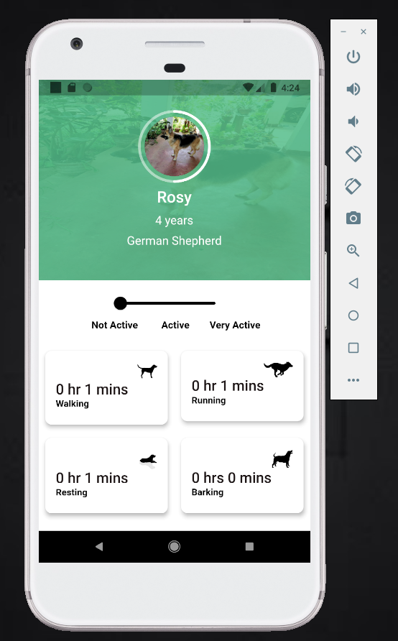
Methodology
Dog activity recognition takes place accordingly (Walk, Run).
The statistics will be updated and will be uploaded to a server. The amount of activity of the dog during motion activity is measured accordingly and will be displayed in the mobile application.
Average activity levels of the dogs based on its breed and age is already in the system obtained the official Wag Walking site[6].The system compares the activity levels based on the breed and age with the standard activity levels and identifies if the dog is active or not.
IT17133678
Boteju W.J.M
2020_045

Slide 24
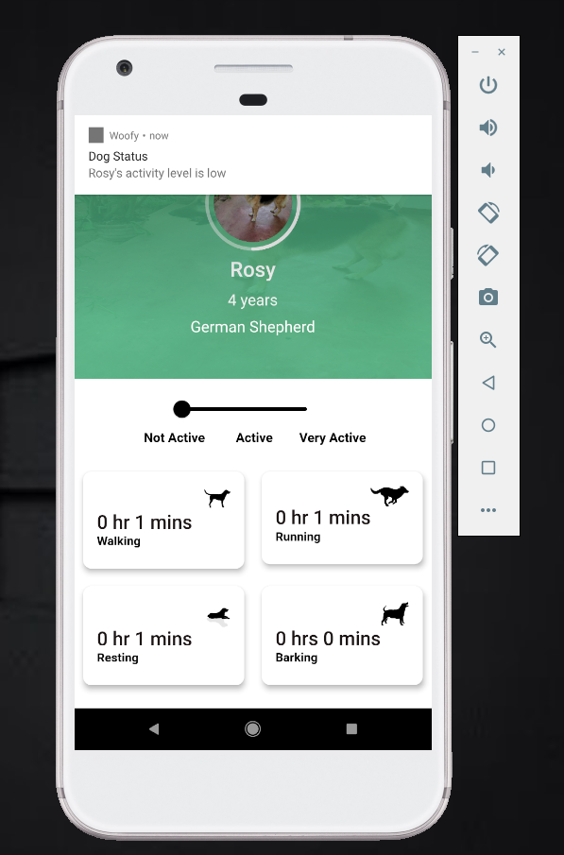
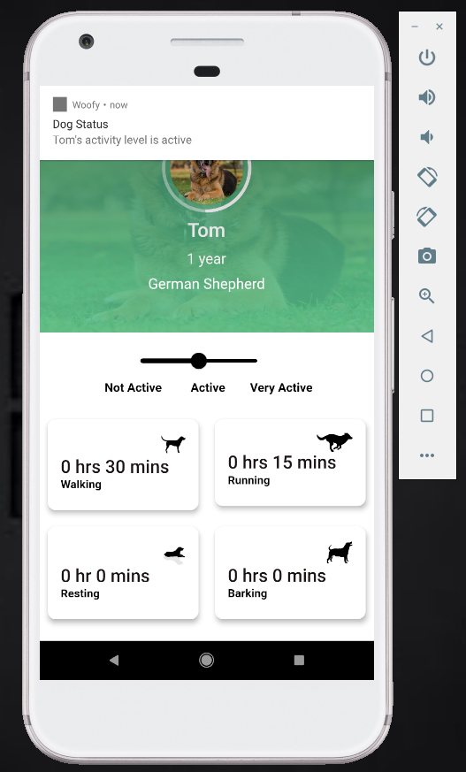
Updates are pushed to mobile application via cellular or Wifi Connection. The health level of the dog is determined, and the user is notified if there is a change in activity levels (Walk, Run).
IT17133678
Boteju W.J.M
2020_045

Slide 25
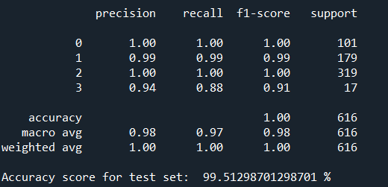
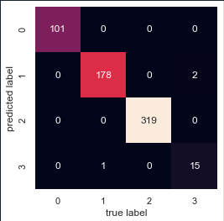
Achievements
Support Vector Machine was used on the test data and an accuracy score of 99.5% accuracy was obtained .
IT17133678
Boteju W.J.M
2020_045

Slide 26

Resting Pattern Recognition
IT17123150
M. D. P. Peiris
2020_045

Slide 27
Background / Research Gap
Most of the dog activity trackers use only sensor device to track resting behavior of the dogs[4].
Very few amount of research studies have done to recognize the resting activity of the dogs using camera footage[5].
So far, it is rare to find a product that uses both sensor data and CCTV camera video feed data to track the resting behavior of the dog.
IT17123150
M. D. P. Peiris
2020_045

Slide 28
Research Question
How to identify behavioral changes in dog’s resting activity based on their breed and age, using both surveillance camera video feed and sensor data?
IT17123150
M. D. P. Peiris
2020_045

Slide 29
Objectives
Ability to identify whether the dog is in resting state, using image processing.
Ability to calculate the resting time using both video feed data and sensor data.
Ability to find activity level changes by compare the calculated resting activity level with the average resting activity level based on dog’s breed and age.
Ability to notify dog owner, if there are changes in resting activity level.
IT17123150
M. D. P. Peiris
2020_045

Slide 30
Methodology
Model | ResNet50
Programming Language | Python, Dart
Libraries | Keras, SciKit learn, Pandas, Numpy, Matplotlib
API Development | Django REST framework
Database | MongoDB
Version Controlling | Gitlab
IT17123150
M. D. P. Peiris
2020_045

Slide 31
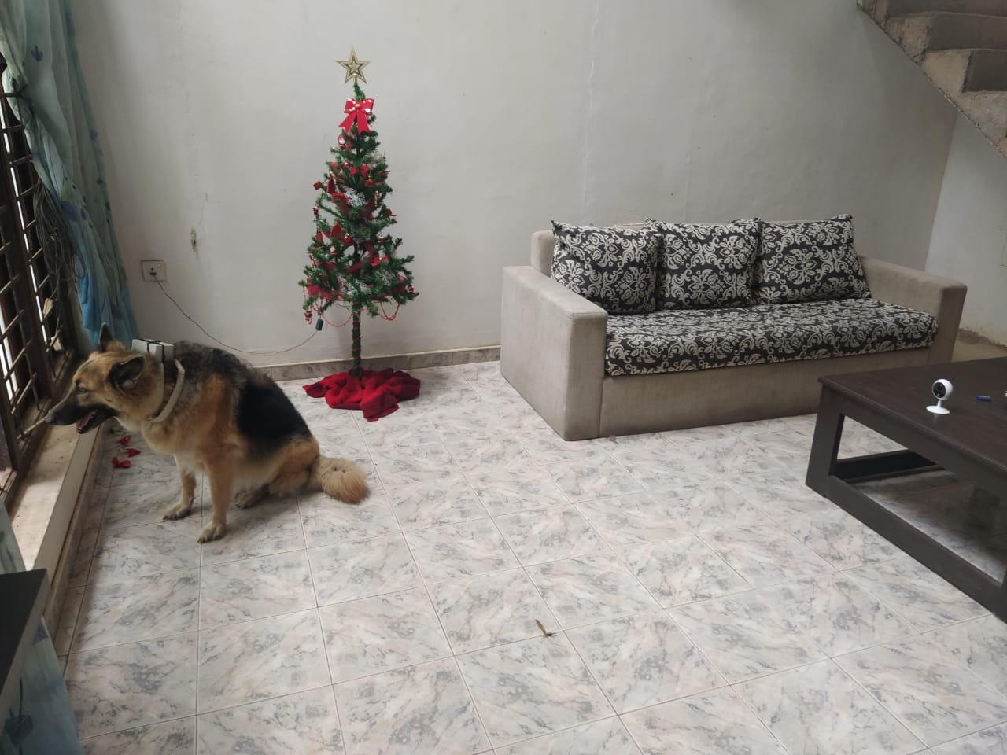
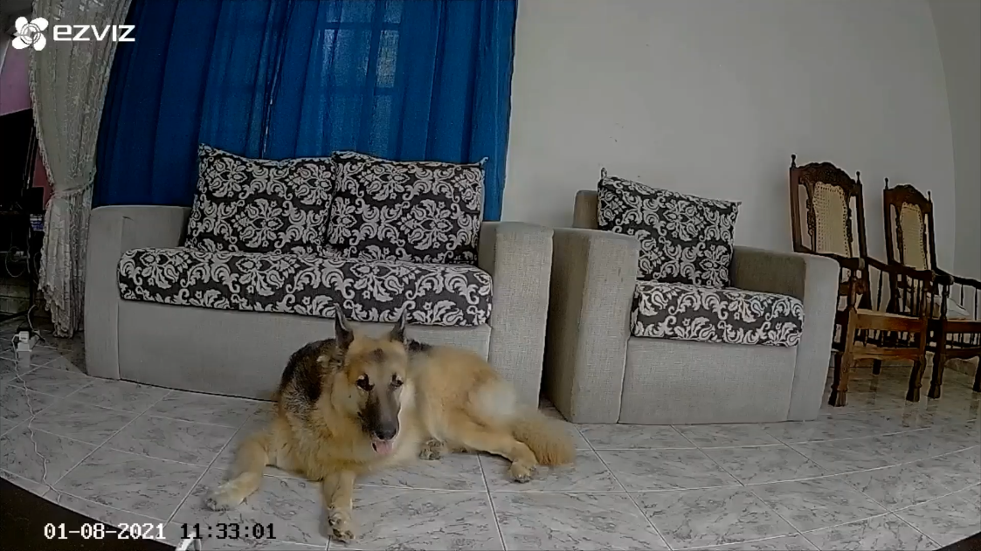
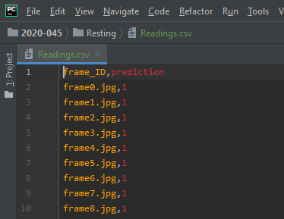
Methodology
WiFi enabled CCTV camera is setted up to a restricted area to capture the real time dog resting video footage. The captured video footage is broken into frames (1 frame per second basis) using OpenCV.
All the frames go through the prediction model which is re-trained using ResNet50 pre-trained transfer learning model based on the classification of lying position and not lying position. Frames with dog lying position are considered as resting behaviour of the dog. They are used calculated the resting time of the dog.
1
2
3
IT17123150
M. D. P. Peiris
2020-045

Slide 32
Methodology
Calculate the resting time value using the number of frames predicted as lying.
In order to provide more accurate and trustworthy result, system calculates the mean resting value using the above calculated value and the resting time value obtained from the IMU-6050 sensor.
Finding the unusual resting behaviour is accomplished by comparing the calculated mean resting time value and the standard resting time (according to the wagwalking.com site) of the dog based on its breed and age[6].
Updates are pushed to the mobile application to notify the user about the resting behaviour of the dog.
IT17123150
M. D. P. Peiris
2020-045

Slide 33
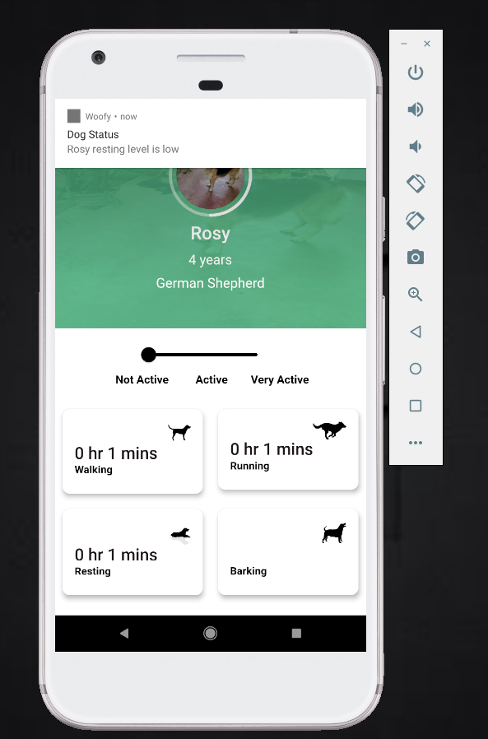
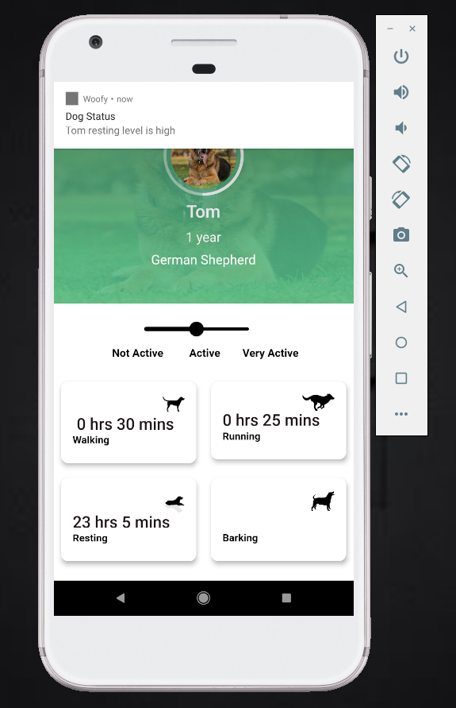
Resting Activity Level Change Notification
Resting Time Update
IT17123150
M. D. P. Peiris
2020-045

Slide 34
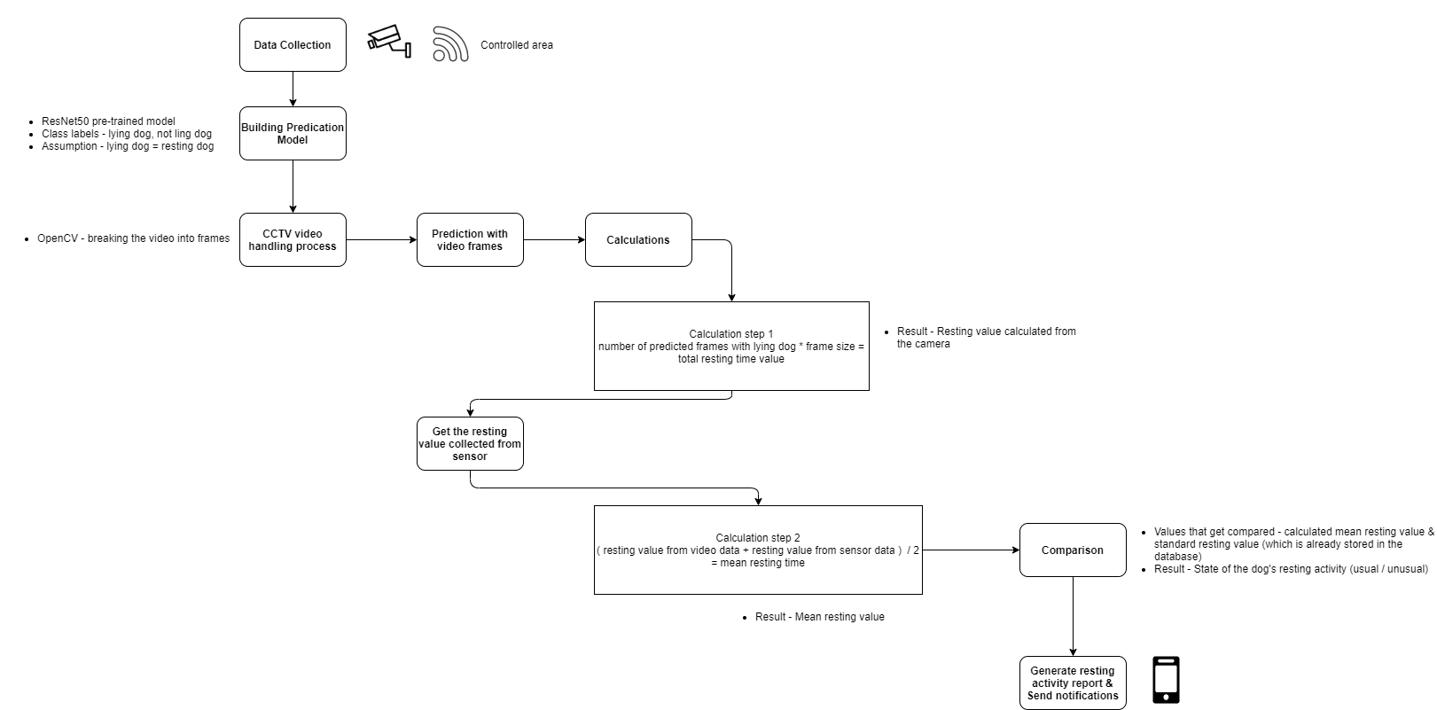
Methodology
Summarized Visual Aid of the Resting Pattern Recognition Methodology
IT17123150
M. D. P. Peiris
2020_045

Slide 35
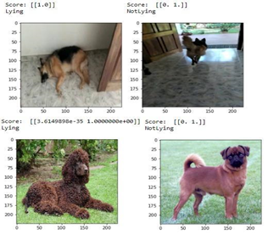
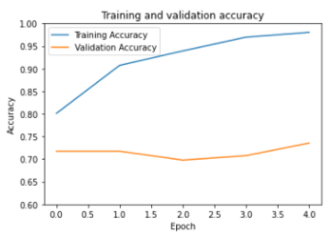
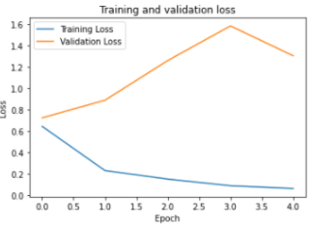
Achievement
Resting activity was predicted with 97% accuracy score.
IT17123150
M. D. P. Peiris
2020_045

Slide 36

Barking Pattern Recognition
IT17141352
A.K.P. Erandi Wathsala
2020-045

Slide 37
Background / Research Gap
There are current systems and products to control barking.
But no system to identify different barking patterns.
No system that notifies the user with identified barking patterns and unusual barking patterns.
CCTV camera is only being used for security purposes.
A.K. P. Erandi Wathsala
2020-045
IT17141352
2020-045

Slide 38
Research Question
How to track and monitor different barking patterns in order to identify the reason that caused using a surveillance camera.
IT17141352
A.K. P. Erandi Wathsala

Slide 39
Objectives
Ability to monitor different barking patterns using a surveillance camera.
Ability to identify different barking patterns using audio processing.
Ability to identify unusual barking patterns .
Notify user
IT17141352
A.K. P. Erandi Wathsala
2020-045

Slide 40
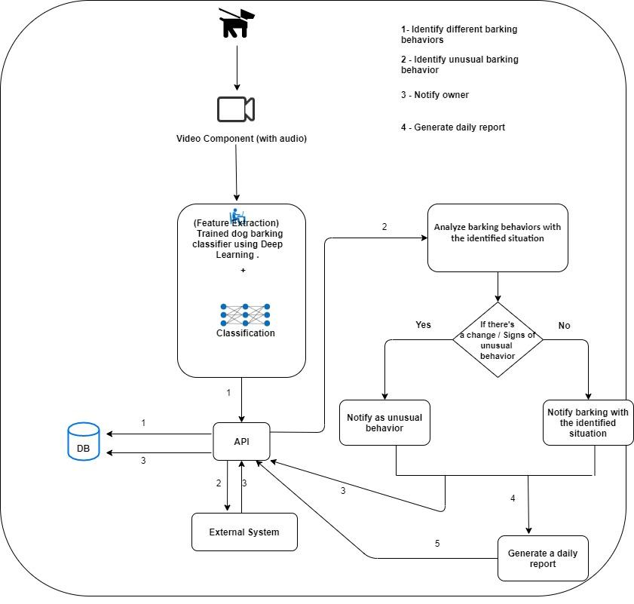
Methodology
IT17141352
A.K. P. Erandi Wathsala
2020-045

Slide 41
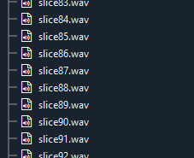
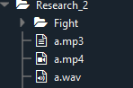
Methodology
EZVIZ Wi-Fi surveillance camera is used to collect real time data within a restricted area using real time streaming protocol.
Each data is a 1min video and convert to MP3 & wav formats later respectively using ffmpeg and pydub libraries. Then each wav file is sliced into 5 seconds of audio file.
IT17141352
A.K. P. Erandi Wathsala
2020-045

Slide 42
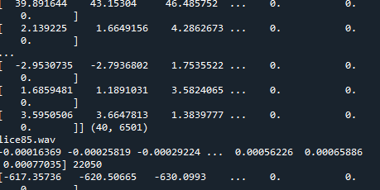
Methodology
Each sliced data was preprocessed and MFCC feature extracted using Librosa python library. Those extracted features are saved.
The final output is predicted after analyzing the feature extracted data by the model and passed to the mobile application.Django rest framework was used as the middleware.
Finally user gets a notification and update status of the barking behavior of the dog based on the final output which was predicted before.

Slide 43
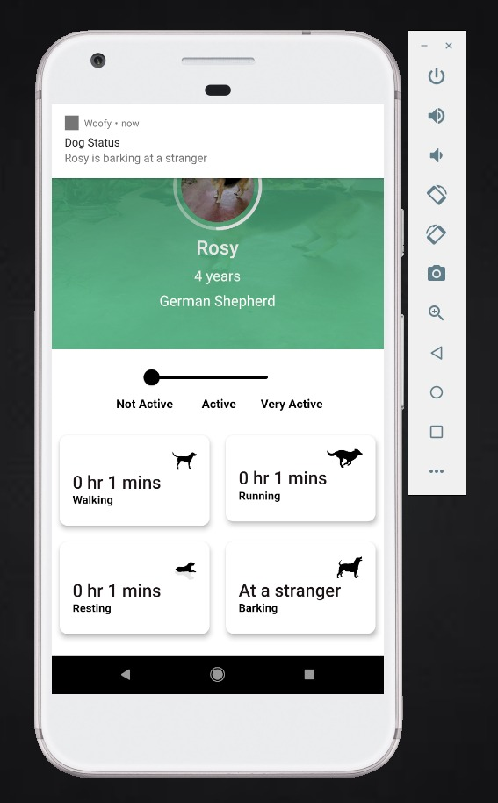
Methodology
Identified Barking Pattern Notification
Barking Pattern Status Update

Slide 44
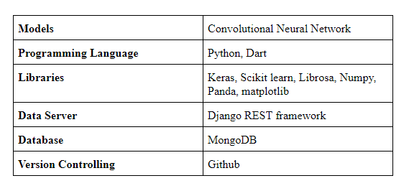
Methodology
A.K . P. Erandi Wathsala
IT17141352
2020-045

Slide 45
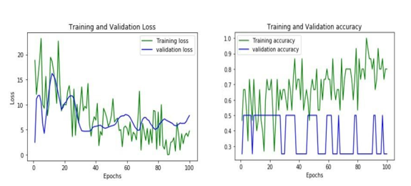
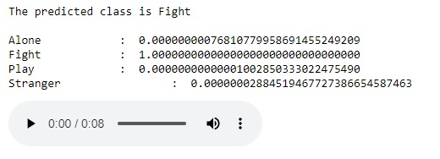
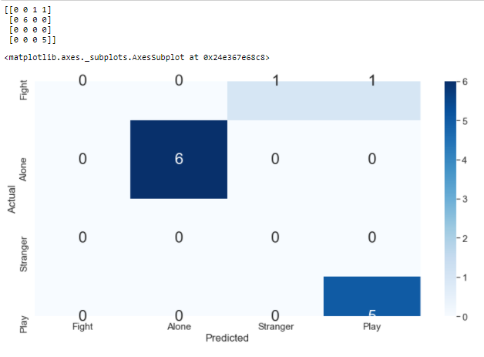
Achievement
Predicted Outcome from the CNN model
IT17141352
A.K. P. Erandi Wathsala
2020-045

Slide 46
Product Demonstration

Slide 48
REFERENCES
[1] Csaba Molnár, Frédéric Kaplan, Pierre Roy, François Pachet, Péter Pongrácz, Antal Dóka, Ádám Miklósi; “ClassiWcation of dog barks: a machine learning approach”, Animal Cognition 11(3):389-400, August 2008. [online] Available at: https://www.researchgate.net/publication/5654967_Classification_of_dog_barks_A_machine_learning_approach
[2] Che Yong Yeo, S.A.R. Al-Haddad, Chee Kyun Ng, “Animal Voice Recognition for Identification (ID) Detection System. [online] Available at: https://www.researchgate.net/profile/Syed_Abdul_Rahman_Al-Haddad/publication/251999286_Animal_voice_recognition_for_identification_ID_detection_system/links/55470d210cf23ff71686f8a6/Animal-voice-recognition-for-identification-ID-detection-system
[3] Mikael Henaff, Kevin Jarrett, Koray Kavukcuoglu and Yann LeCun, “UNSUPERVISED LEARNING OF SPARSE FEATURES FOR SCALABLE AUDIO CLASSIFICATION”, 12th International Society for Music Information Retrieval Conference (ISMIR 2011). [online] Available at: https://archives.ismir.net/ismir2011/paper/000128.pdf
[4]FitBark. 2021. Fitbark GPS Dog Trackers & Activity Monitors | Healthy Together. [online] Available at: <https://www.fitbark.com/> [Accessed 9 January 2021].
[5] S. Air, A. Zamansky, & Linden Dvd., “K9-Blyzer: Towards Video-Based Automatic Analysis of Canine Behavior”, Fourth International Conference on Animal-Computer Interaction (ACI2017), 2017.
[6]"Dog Breed Guides", WagWalking, 2020. [Online]. Available: https://wagwalking.com/breed. [Accessed: 31- Oct- 2020].

Slide 49
Thank You
Any Questions…?

